Slide 1
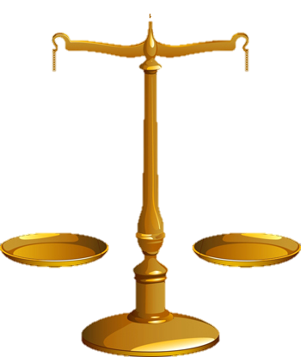
Rez day 2019
the
OF SIN
WEIGHT
OKLAHOMA CITY

Slide 2
Rez day 2019
How much does sin weigh?
Murder
Rape
Soap Operas
weigh more than
Pride
Worry
Procrastination
Does
=
?
WEIGHT
OF SIN
the
OKLAHOMA CITY

Slide 3
Rez day 2019
Which is greater?
or the
the
sin of
?
mission
o
com
WEIGHT
OF SIN
the
OKLAHOMA CITY

Slide 4
Rez day 2019
WEIGHT
OF SIN
the
OKLAHOMA CITY

Slide 5
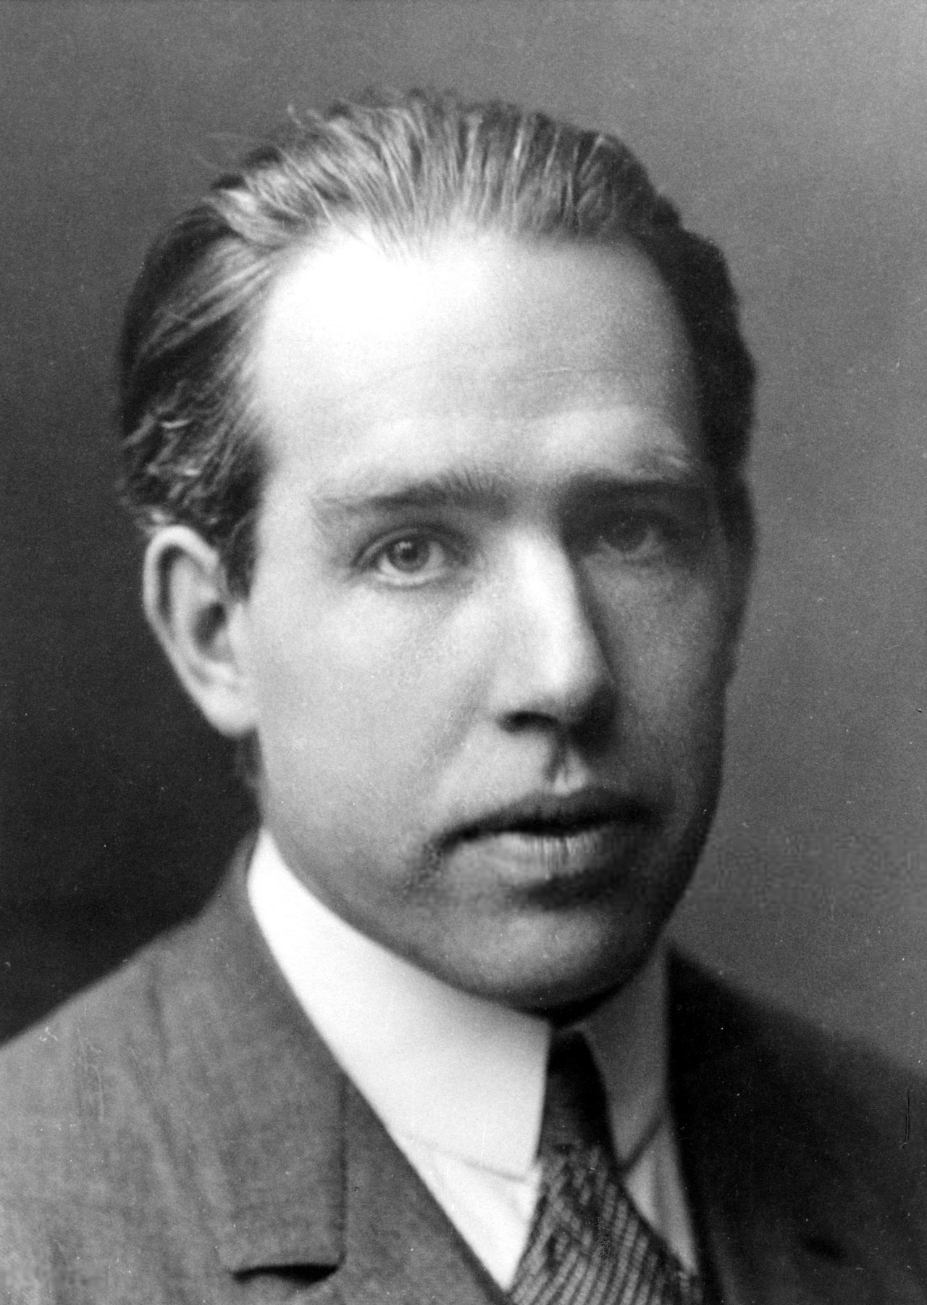
Rez day 2019
Neils Bohr (1885-1962) (Nobel prize-winner in physics, 1922) ~ “Nearby our vacation house in Tisvilde lives a man who has a horseshoe above his door, after the old superstition that it brings luck. When a friend asked him ‘Are you superstitious? Do you really believe the horseshoe brings luck?’ He replied ‘Of course not; but they say it also helps even if you don’t believe it.’”
WEIGHT
OF SIN
the
OKLAHOMA CITY

Slide 6
Rez day 2019
WEIGHT
OF SIN
the
OKLAHOMA CITY

Slide 7
Rez day 2019
I’m not going
to let you do that.
I’ve just finished the surgery. I’m about to close.
Suture yourself.
What’s going on?
I’ll close my own incision.
WEIGHT
OF SIN
the
OKLAHOMA CITY

Slide 8
Rez day 2019
Rom. 5:12 ~ Therefore, just as through one man sin entered the world, and death through sin, and thus death spread to all men, because all sinned …
WEIGHT
OF SIN
the
OKLAHOMA CITY

Slide 9
Rez day 2019
WEIGHT
OF SIN
the
OKLAHOMA CITY

Slide 10
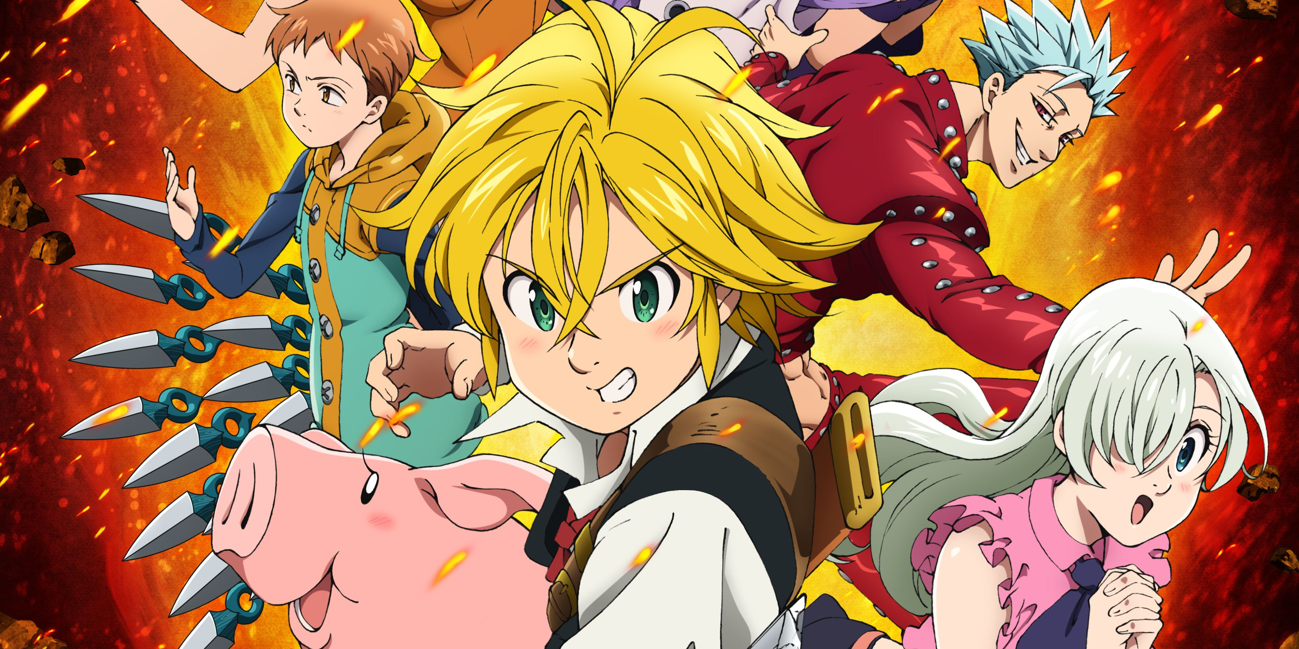
Rez day 2019
The 7 deadly sins
pride
greed
lust
anger
gluttony
envy
laziness
WEIGHT
OF SIN
the
OKLAHOMA CITY

Slide 11
Rez day 2019
WEIGHT
OF SIN
the
OKLAHOMA CITY

Slide 12
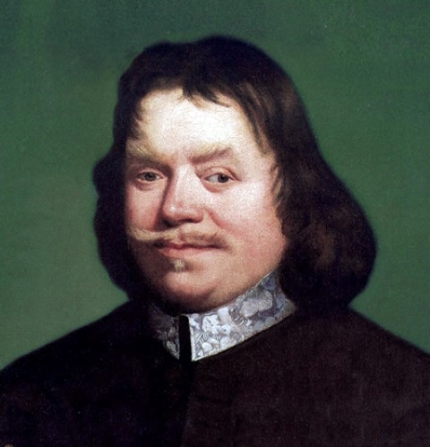
Rez day 2019
John Bunyan (1628-1688) ~ “One leak will sink a ship; and one sin will destroy a sinner.”
Not all sin is equal
But all sin equally condemns
WEIGHT
OF SIN
the
OKLAHOMA CITY

Slide 13
Rez day 2019
WEIGHT
OF SIN
the
OKLAHOMA CITY

Slide 14
Rez day 2019
Matt. 11:21-24 (Phillips) ~ ²¹ “Woe to you, Chorazin! Woe to you, Bethsaida! For if the mighty works which were done in you had been done in Tyre and Sidon, they would have repented long ago in sackcloth and ashes. ²² But I say to you, it will be more tolerable for Tyre and Sidon in the day of judgment than for you. ²³ And you, Capernaum, who are exalted to heaven, will be brought down to Hades; for if the mighty works which were done in you had been done in Sodom, it would have remained until this day. ²⁴ But I say to you that it shall be more tolerable for the land of Sodom in the day of judgment than for you.”
WEIGHT
OF SIN
the
OKLAHOMA CITY

Slide 15
Rez day 2019
WEIGHT
OF SIN
the
OKLAHOMA CITY

Slide 16
Rez day 2019
Luke 22:44 ~ And being in agony, He prayed more earnestly. Then His sweat became like great drops of blood falling down to the ground.
agony ~ agōnia
From agōn – usually translated conflict
great drops ~ thrombos – thrombosis
Matt. 26:38a ~ Then He said to them, “My soul is exceedingly sorrowful, even to death.”
WEIGHT
OF SIN
the
OKLAHOMA CITY

Slide 17
Rez day 2019
John 12:27 ~ “Now My soul is troubled, and what shall I say? ‘Father, save Me from this hour’? But for this purpose I came to this hour.’”
WEIGHT
OF SIN
the
OKLAHOMA CITY

Slide 18
Rez day 2019
WEIGHT
OF SIN
the
OKLAHOMA CITY

Slide 19
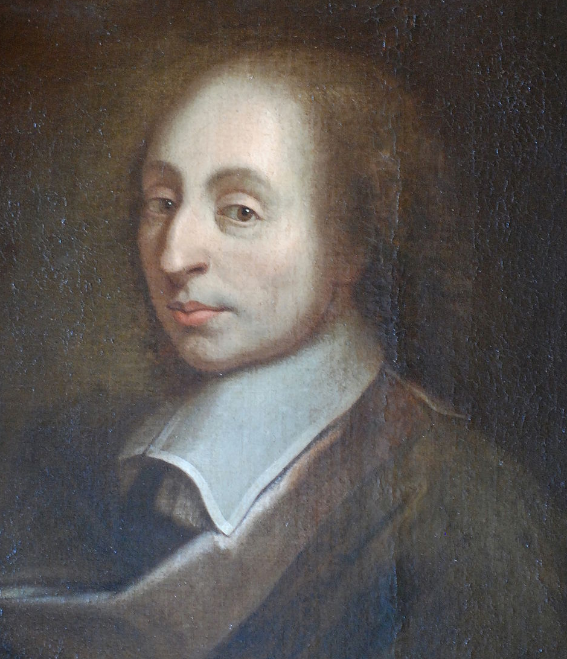
Rez day 2019
Blaise Pascal (1623-1662) ~ “Jesus suffers in his Passion the torments inflicted upon him by men, but in his agony he suffers the torments which he inflicts on himself. He was troubled. This punishment is inflicted by no human but an almighty hand, and only He that is almighty can bear it.” (Pensées)
WEIGHT
OF SIN
the
OKLAHOMA CITY

Slide 20
Rez day 2019
Is. 53:6 ~ All we like sheep have gone astray; We have turned, every one, to his own way; And the Lord has laid on Him the iniquity of us all.
sin
sin
sin
sin
sin
sin
sin
sin
sin
sin
sin
sin
sin
sin
sin
sin
sin
sin
sin
sin
sin
sin
sin
sin
sin
sin
sin
sin
sin
sin
sin
sin
sin
sin
sin
sin
sin
sin
sin
sin
sin
sin
sin
sin
sin
sin
sin
sin
sin
sin
sin
sin
sin
sin
sin
sin
sin
sin
sin
sin
sin
sin
sin
sin
sin
sin
sin
sin
sin
sin
sin
sin
sin
sin
sin
sin
sin
sin
sin
sin
sin
sin
sin
sin
sin
sin
sin
sin
sin
sin
sin
sin
sin
sin
sin
sin
sin
sin
sin
sin
sin
sin
sin
sin
sin
sin
sin
sin
sin
sin
sin
sin
sin
sin
sin
sin
sin
sin
sin
sin
sin
sin
sin
sin
sin
sin
sin
sin
sin
sin
sin
sin
sin
sin
sin
sin
sin
sin
sin
sin
sin
sin
sin
sin
sin
sin
sin
sin
sin
sin
sin
sin
sin
sin
sin
sin
sin
sin
sin
sin
sin
sin
sin
sin
sin
sin
sin
sin
sin
sin
sin
sin
sin
sin
sin
sin
sin
sin
sin
sin
sin
sin
sin
sin
sin
sin
sin
sin
sin
sin
sin
sin
sin
sin
sin
sin
sin
sin
sin
sin
sin
sin
sin
sin
sin
sin
sin
sin
sin
sin
sin
sin
sin
sin
sin
sin
sin
sin
sin
sin
sin
sin
sin
sin
sin
sin
sin
sin
sin
sin
sin
sin
sin
sin
sin
sin
sin
sin
sin
sin
sin
sin
sin
sin
sin
sin
sin
sin
sin
sin
sin
sin
sin
sin
sin
sin
sin
sin
sin
sin
sin
sin
sin
sin
sin
sin
sin
sin
sin
sin
sin
sin
sin
sin
sin
sin
sin
sin
sin
sin
sin
sin
sin
sin
sin
sin
sin
sin
sin
sin
sin
sin
sin
sin
sin
sin
sin
sin
sin
sin
sin
sin
sin
sin
sin
sin
sin
sin
sin
sin
sin
sin
sin
sin
sin
sin
sin
sin
sin
sin
sin
sin
sin
sin
sin
sin
sin
sin
sin
sin
sin
sin
sin
sin
sin
sin
sin
sin
sin
sin
sin
sin
sin
sin
sin
sin
sin
sin
sin
sin
sin
sin
sin
sin
sin
sin
sin
sin
sin
sin
sin
sin
sin
sin
sin
sin
sin
sin
sin
sin
sin
sin
sin
sin
sin
sin
sin
sin
sin
sin
sin
sin
sin
sin
sin
sin
sin
sin
sin
sin
sin
sin
sin
sin
sin
sin
sin
sin
sin
sin
sin
sin
sin
sin
sin
sin
sin
sin
sin
sin
sin
sin
sin
sin
sin
sin
sin
sin
sin
sin
sin
sin
sin
sin
sin
sin
sin
sin
sin
sin
sin
sin
sin
sin
sin
sin
sin
sin
sin
sin
sin
sin
sin
sin
sin
sin
sin
sin
sin
sin
sin
sin
sin
sin
sin
sin
sin
sin
sin
sin
sin
sin
sin
sin
sin
sin
sin
sin
sin
sin
sin
sin
sin
sin
sin
sin
sin
sin
sin
sin
sin
sin
sin
sin
sin
sin
sin
sin
sin
sin
sin
sin
sin
sin
sin
sin
sin
sin
sin
sin
sin
sin
sin
sin
sin
sin
sin
sin
sin
sin
sin
sin
sin
sin
sin
sin
sin
sin
sin
sin
sin
sin
sin
sin
sin
sin
sin
sin
sin
sin
sin
sin
sin
sin
sin
sin
sin
sin
sin
sin
sin
sin
sin
sin
sin
sin
sin
sin
sin
sin
sin
sin
sin
sin
sin
sin
sin
sin
sin
sin
sin
sin
sin
sin
sin
sin
sin
sin
sin
sin
sin
sin
sin
sin
sin
sin
sin
sin
sin
sin
sin
sin
sin
sin
sin
sin
sin
sin
sin
sin
sin
sin
sin
sin
sin
sin
sin
sin
sin
sin
sin
sin
sin
sin
sin
sin
sin
sin
sin
sin
sin
sin
sin
sin
sin
sin
sin
sin
sin
sin
sin
sin
sin
sin
sin
sin
sin
sin
sin
sin
sin
sin
sin
sin
sin
sin
sin
sin
sin
sin
sin
sin
sin
sin
sin
sin
sin
sin
sin
sin
sin
sin
sin
sin
sin
sin
sin
sin
sin
sin
sin
sin
sin
sin
sin
sin
sin
sin
sin
sin
sin
sin
sin
sin
sin
sin
sin
sin
sin
sin
sin
sin
sin
sin
sin
sin
sin
sin
sin
sin
sin
sin
sin
sin
sin
sin
sin
sin
sin
sin
sin
sin
sin
sin
sin
sin
sin
sin
sin
sin
sin
sin
sin
sin
sin
sin
sin
sin
sin
sin
sin
sin
sin
sin
sin
sin
sin
sin
sin
sin
sin
sin
sin
sin
sin
sin
sin
sin
sin
sin
sin
sin
sin
sin
sin
sin
sin
sin
WEIGHT
OF SIN
the
OKLAHOMA CITY

Slide 21
Rez day 2019
Heb. 12:2 ~ looking unto Jesus, the author and finisher of our faith, who for the joy that was set before Him endured the cross, despising the shame, and has sat down at the right hand of the throne of God.
WEIGHT
OF SIN
the
OKLAHOMA CITY

Slide 22
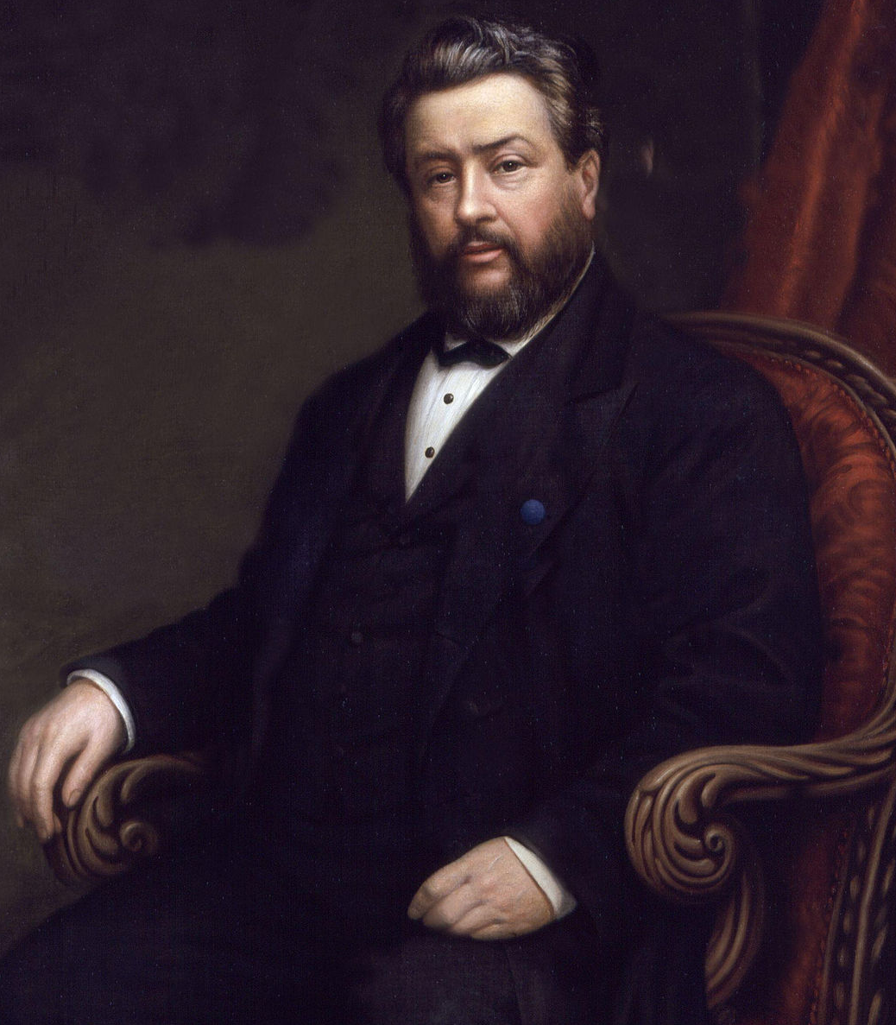
Rez day 2019
Charles Spurgeon (1834-1892) ~ “The enormous load of human guilt Was on my Savior laid; With woes as with a garment he For sinners was array’d.”
WEIGHT
OF SIN
the
OKLAHOMA CITY

Slide 23
Rez day 2019
WEIGHT
OF SIN
the
OKLAHOMA CITY

Slide 24
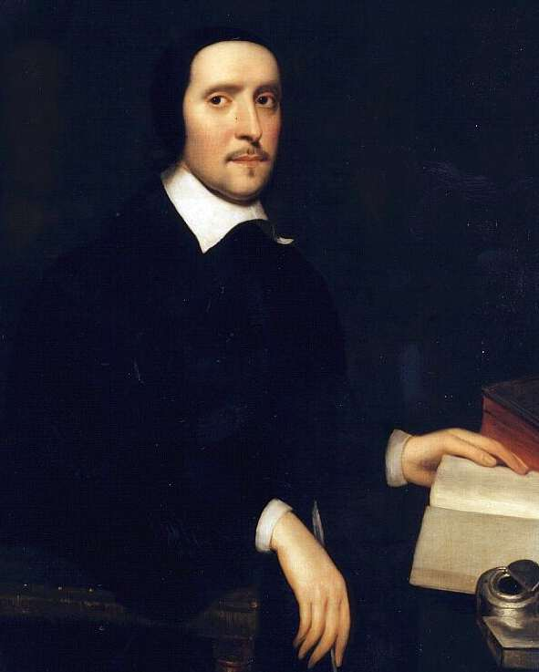
Rez day 2019
Jeremy Taylor (1613-1667) ~ “Men prefer a prosperous error to an afflicted truth.”
WEIGHT
OF SIN
the
OKLAHOMA CITY

Slide 25
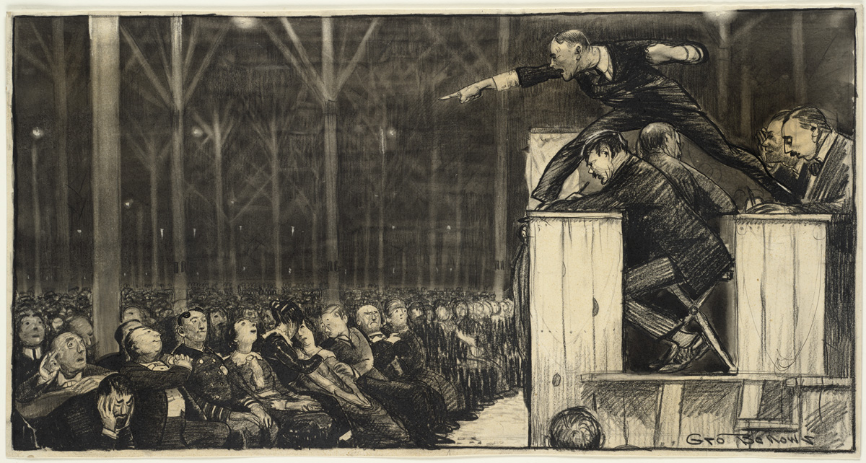
Rez day 2019
Billy Sunday (1862-1935) ~ “One reason sin flourishes is that it is treated like a cream puff instead of a rattlesnake.”
WEIGHT
OF SIN
the
OKLAHOMA CITY

Slide 26
Rez day 2019
WEIGHT
OF SIN
the
OKLAHOMA CITY

Slide 27
Rez day 2019
WEIGHT
OF SIN
the
OKLAHOMA CITY

Slide 28
Rez day 2019
Guilt is to the soul much of what pain is to the body.
F
pain
guilt
WEIGHT
OF SIN
the
OKLAHOMA CITY

Slide 29
Rez day 2019
WEIGHT
OF SIN
the
OKLAHOMA CITY

Slide 30
Rez day 2019
Is. 55:1-2 ~ ¹ “Ho! Everyone who thirsts, come to the waters;
And you who have no money,
Come, buy and eat.
Yes, come, buy wine and milk without money and without price.
² Why do you spend money for what is not bread,
And your wages for what does not satisfy?
Listen carefully to Me, and eat what is good,
And let your soul delight itself in abundance.”
WEIGHT
OF SIN
the
OKLAHOMA CITY

Slide 31
Rez day 2019
Jerusalem in the Time of Jesus
Bronze Atlar
The Feast of Tabernacles (Sukkot)
Pool of Siloam
Gihon Springs
WEIGHT
OF SIN
the
OKLAHOMA CITY

Slide 32
Rez day 2019
John 7:37-38 ~ ³⁷ On the last day, that great day of the feast, Jesus stood and cried out, saying, “If anyone thirsts, let him come to Me and drink. ³⁸ He who believes in Me, as the Scripture has said, out of his heart will flow rivers of living water.”
WEIGHT
OF SIN
the
OKLAHOMA CITY

Slide 33
Rez day 2019
Rom. 8:12-16 (NLT) ~ ¹² So, dear brothers and sisters, you have no obligation whatsoever to do what your sinful nature urges you to do. ¹³ For if you keep on following it, you will perish. But if through the power of the Holy Spirit you turn from it and its evil deeds, you will live. ¹⁴ For all who are led by the Spirit of God are children of God.
¹⁵ So you should not be like cowering, fearful slaves.
WEIGHT
OF SIN
the
OKLAHOMA CITY

Slide 34
Rez day 2019
Rom. 8:12-16 (NLT) ~ You should behave instead like God’s very own children, adopted into his family — calling him “Father, dear Father.” ¹⁶ For his Holy Spirit speaks to us deep in our hearts and tells us that we are God’s children.
WEIGHT
OF SIN
the
OKLAHOMA CITY

Slide 35
Rez day 2019
Rom. 5:1 ~ Therefore, having been justified by faith, we have peace with God through our Lord Jesus Christ,
WEIGHT
OF SIN
the
OKLAHOMA CITY

Slide 36
Rez day 2019
WEIGHT
OF SIN
the
OKLAHOMA CITY

Slide 37
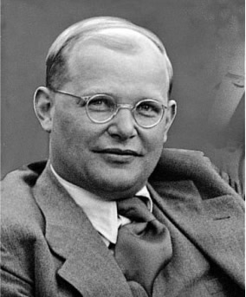
Rez day 2019
Dietrich Bonhoeffer (1906-1945) ~ “Anybody who has once been horrified by the dreadfulness of his own sin that nailed Jesus to the cross will no longer be horrified by even the rankest sins of a brother.”
WEIGHT
OF SIN
the
OKLAHOMA CITY

Slide 38
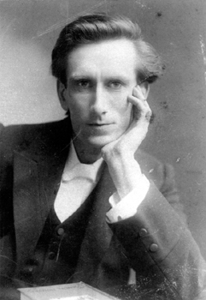
Rez day 2019
Oswald Chambers (1874-1917) ~ “Measure your growth in grace by your sensitiveness to sin.”
WEIGHT
OF SIN
the
OKLAHOMA CITY

Slide 39
Rez day 2019
WEIGHT
OF SIN
the
OKLAHOMA CITY

Slide 40
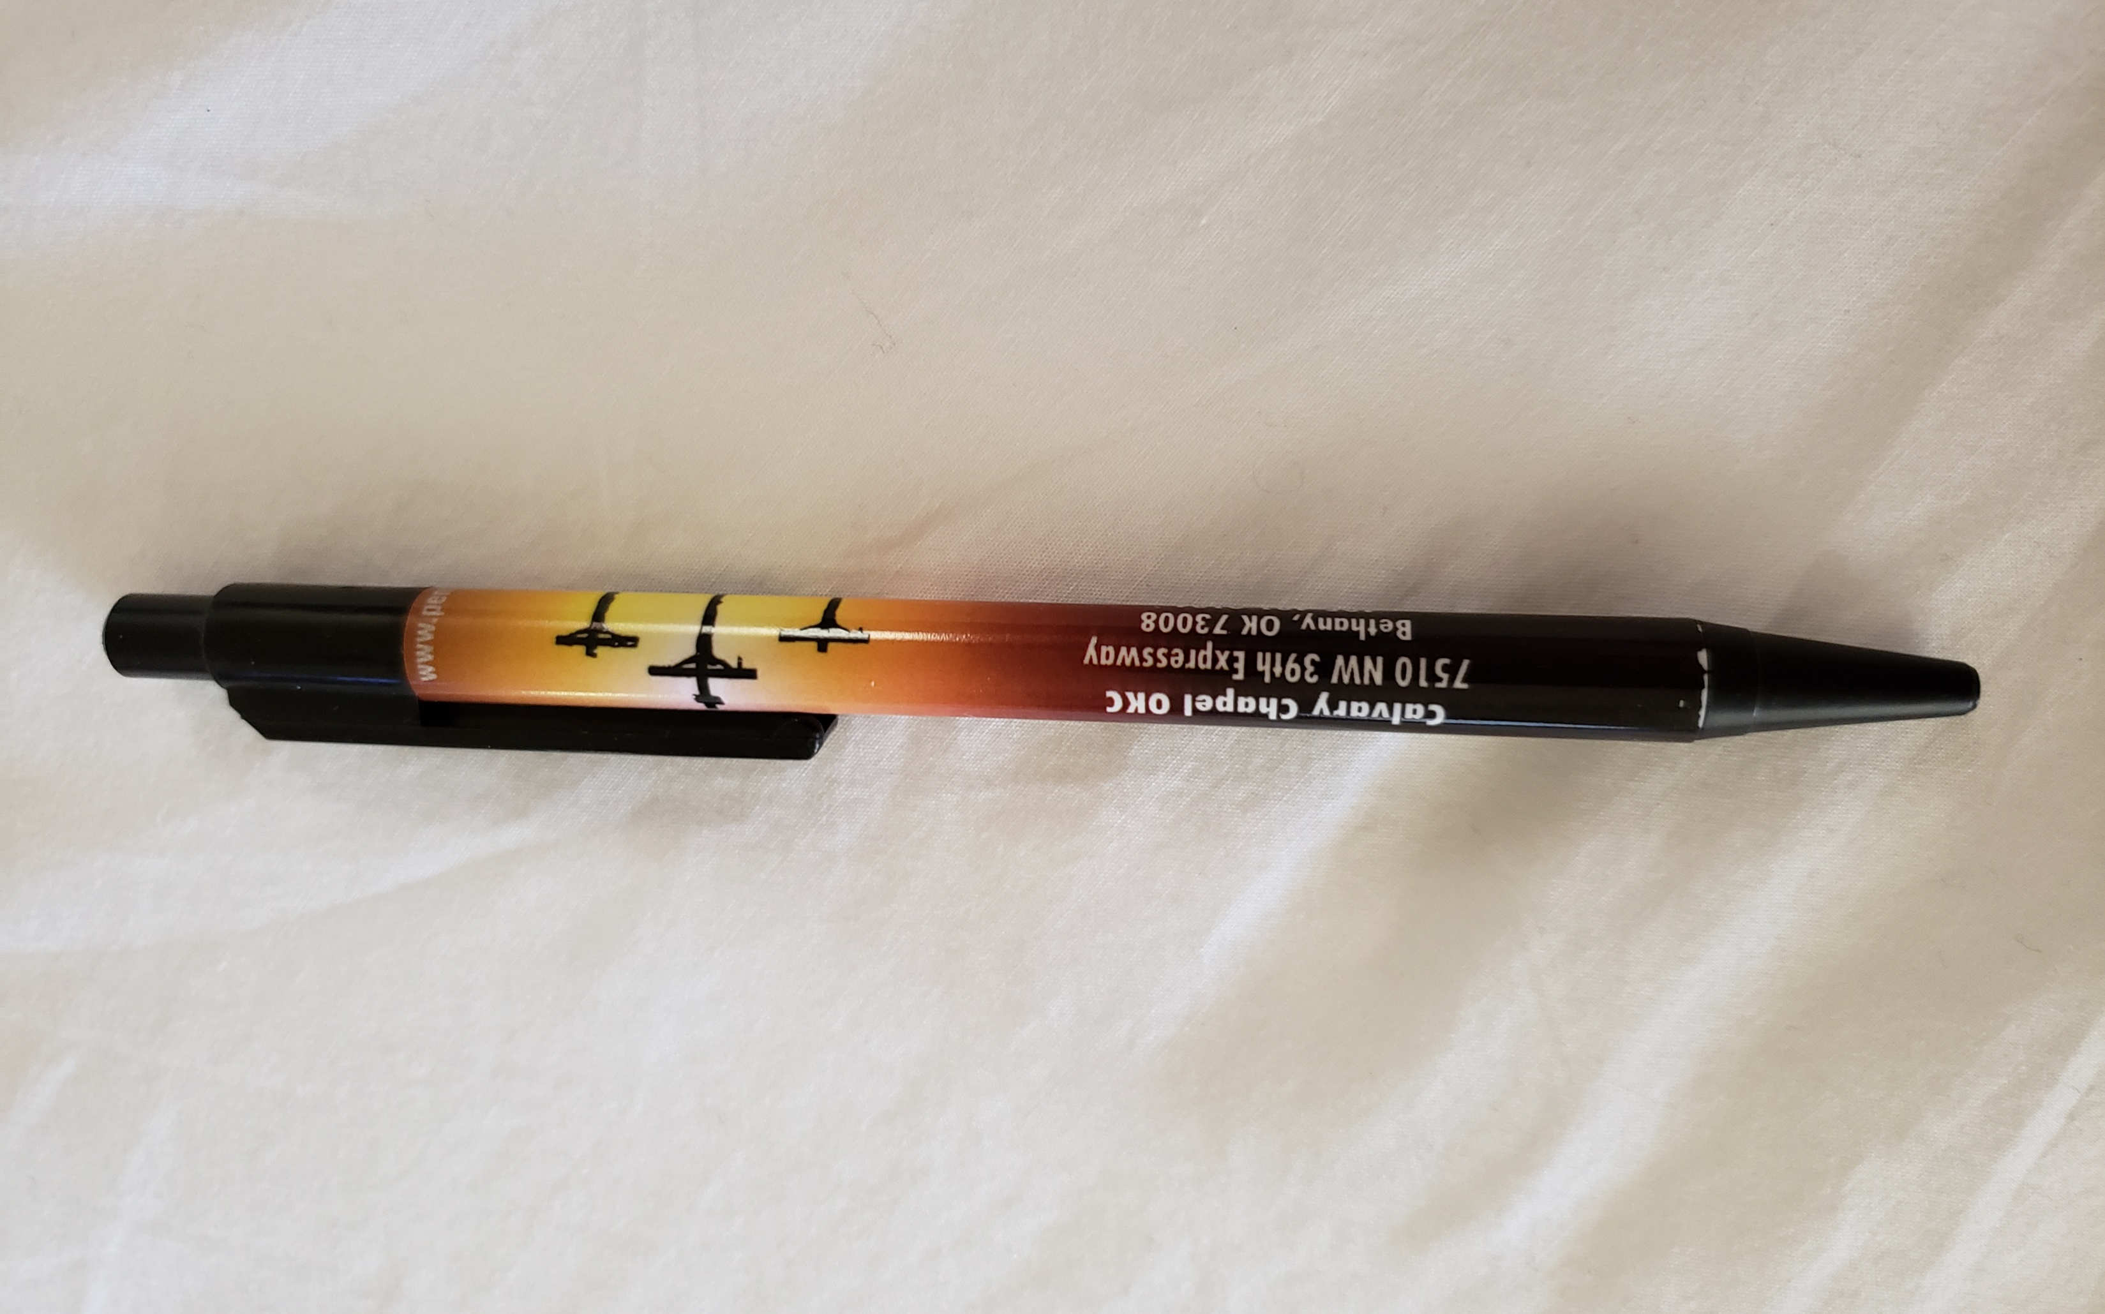
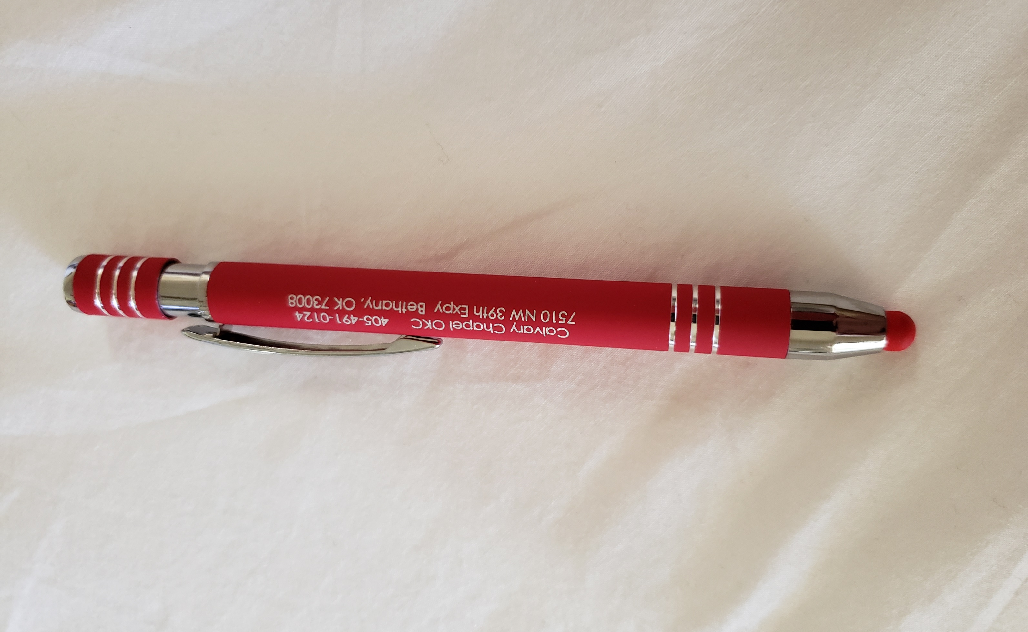
Rez day 2019
a CCOKC pen
also a CCOKC pen
WEIGHT
OF SIN
the
OKLAHOMA CITY

Slide 41
Rez day 2019
WEIGHT
OF SIN
the
OKLAHOMA CITY

Slide 42
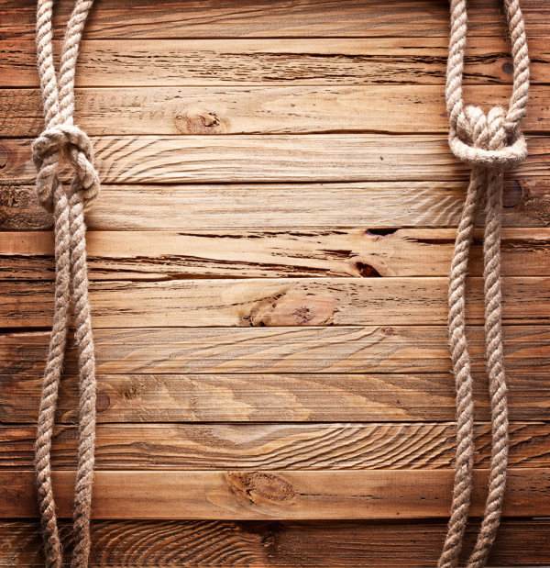
Rez day 2019
Matt. 11:28-30 ~ ²⁸ “Come to Me, all you who labor and are heavy laden, and I will give you rest. ²⁹ Take My yoke upon you and learn from Me, for I am gentle and lowly in heart, and you will find rest for your souls. ³⁰ For My yoke is easy and My burden is light.”
Our
Yokes
Fit
Zugoi Mou Crhstoi
WEIGHT
OF SIN
the
OKLAHOMA CITY

Slide 43
Rez day 2019
Phil. 4:7 ~ and the peace of God, which surpasses all understanding, will guard your hearts and minds through Christ Jesus.
WEIGHT
OF SIN
the
OKLAHOMA CITY

Slide 44
Rez day 2019
WEIGHT
OF SIN
the
OKLAHOMA CITY

Slide 45
Rez day 2019
Jesus is life
The rest is just details
WEIGHT
OF SIN
the
OKLAHOMA CITY

Slide 46
Rez day 2019
WEIGHT
OF SIN
the
OKLAHOMA CITY

